Slide 1

EYE DONATION : WHAT ONE MUST KNOW!!

Slide 2
CURRENT SCENARIO - WORLD
Blindness is a global health concern, with 90% of visually impaired residing in the developing world.
According to the World Health Organization (WHO), 80% of this blindness is either preventable or treatable.
Corneal blindness constitutes 5% of cases globally and is second only to cataract and glaucoma.

Slide 3
CURRENT BURDEN - INDIA
More than 1.2–1.3 million people in India are estimated to have bilateral corneal blindness.
Approximately 10–11 million people have unilateral corneal blindness or significant visual impairment due to corneal disease.
Around 20,000–25,000 new cases of corneal blindness occur annually.
Corneal opacity accounts for approximately 8% of blindness among adults aged ≥50 years in the latest national survey, making it one of the major causes after cataract.

Slide 4
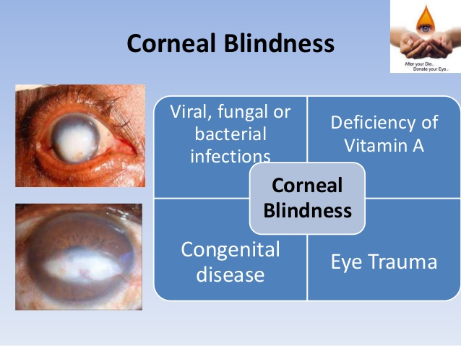
CAUSES OF CORNEAL BLINDNESS
VIRAL, FUNGAL , BACTERIAL INFECTIONS
KERATOCONUS
GENETIC DISEASES
EYE TRAUMA

Slide 5

EYE DONATION

Slide 6

WHO CAN DONATE EYES?

Slide 7
WHO CANNOT
Absolute Contraindications
Human Immunodeficiency Virus (HIV/AIDS)
Rabies
Active septicemia (bloodstream infection

Slide 8
Do's and Don'ts for Eye Donation
Inform the nearest eye bank immediately after death, preferably within 4–6 hours.
Close the eyelids gently after death.
Place a clean, moist cloth over the closed eyes if advised by the eye bank.
Keep the head slightly elevated (about 6 inches) by placing a pillow under the head to reduce swelling.
Switch off ceiling fans directly above the body to prevent drying of the cornea.

Slide 9
Share the deceased's medical history honestly with the eye bank team.
Allow trained eye bank personnel to retrieve the corneas using sterile techniques.
Encourage family members to support the donation process, as consent from the next of kin is generally required.

Slide 10
Don'ts
Do not delay contacting the eye bank after death.
Do not place ice or water directly on the eyes.
Do not apply eye drops, ointments, or home remedies unless instructed by medical personnel.
Do not press or rub the eyes, Do not keep the eyes open, as this can dry the cornea.
Do not assume poor eyesight, cataracts, or wearing glasses disqualifies donation. These conditions often do not prevent corneal donation.

Slide 11
RETRIEVAL OF THE TISSUE
Retrieval procedure could be either enucleation of the whole globe or Corneal scleral rim excision.
The retrieval procedures should be documented in detail in each eye bank in their Standard Operative procedure manual.

Slide 12
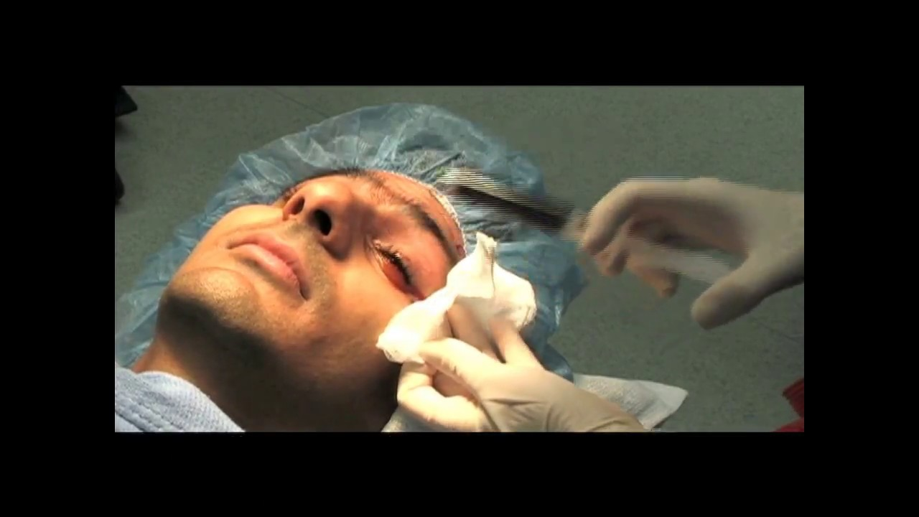
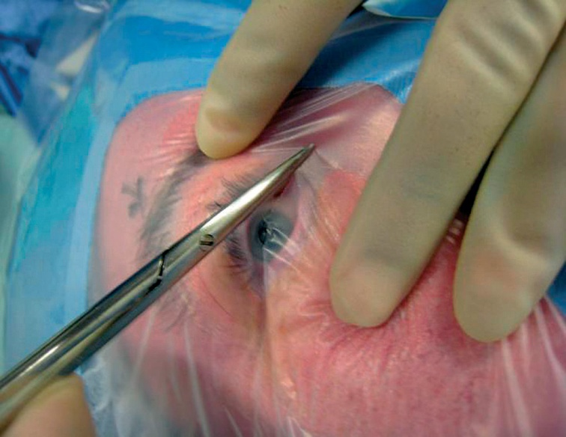
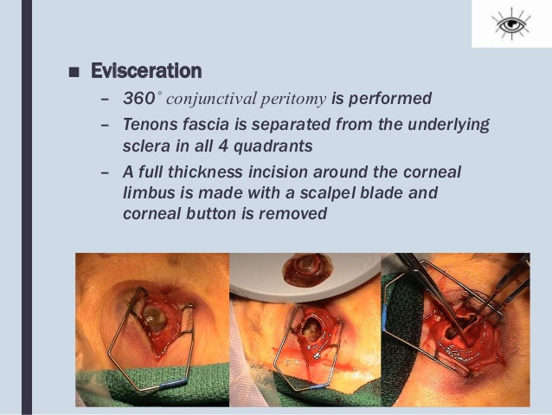
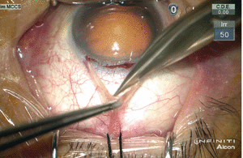
PROCEDURE : CORNEAL BUTTON

Slide 13
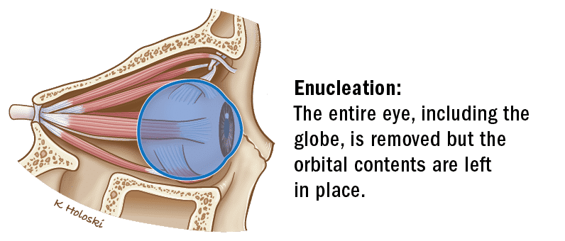
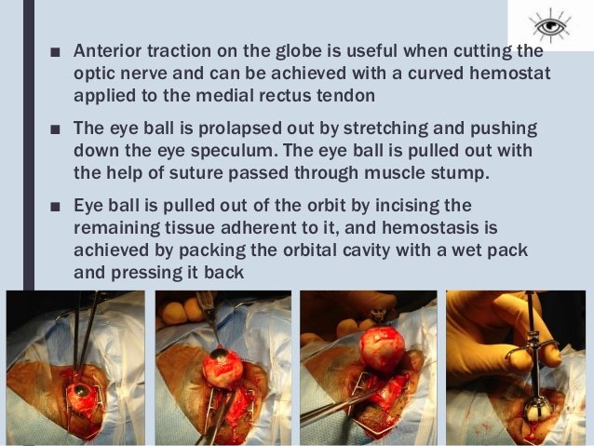
ENUCLEATION

Slide 14
THANK YOU

